Slide 1
Artificial Intelligence
(Machine Learning & Deep Learning)
{
Implementation of OOP Principals in Python
}
...

Slide 2
{
..
"First, solve the problem. Then, write the code." – John Johnson
}
..

Slide 3
Contents of Day 7
Conditional Execution & Loops
Recap & introduction | Review of Functions & Exception Handling.
Core Thoery | • Classes, Objects, Constructors, Destructors, Instance vs. Class Variables. • Inheritance (Multilevel, Hierarchical, Multiple) & Method Resolution Order (MRO). • Access Specifiers (Private, Public, Protected) & Name Mangling. • Association, Aggregation, and Composition.
Lab Practice | Practical coding tasks creating classes, instantiating objects, defining methods, and using constructors/destructors.
Advance Lab | Implementing inheritance structures, using access specifiers to secure data, and coding object relationships.
Wrap-up & Q&A | Debugging OOP logic, resolving MRO conflicts, and preparing for tomorrow's topic: Descriptive Statistics and Probability.
Important:
Use of AI for solving given task is now allowed.
Cellphones must be put on silent.

Slide 4
Today Objective - Classes and Objects
Why OOP matters ?
When you use tools like PyTorch or TensorFlow, everything is an object. A Neural Network is a Class. The layers inside it are Objects. If you don't understand OOP, you cannot build advanced AI architectures.
Yesterday, we built individual "machines" (Functions) to perform specific tasks. Today, we are building the entire factory.
Object-Oriented Programming (OOP) allows us to bundle our data (variables) and our machines (functions) together into one organized, smart package.
}
..

Slide 5
Core Concept (Definition & Rules)
Definition:
Classes and Objects
Rules:
Class: A user-defined prototype or blueprint from which objects are created. It encapsulates data and functions into a single unit.
Object: A specific instance of a class in memory, containing actual values (state) and behaviors.
The Analogy:
The Class: A cookie cutter. It is just a design of a star; it is not food .
The Object: The actual baked cookie. You can use one cookie cutter to make 100 actual cookies.
Classes should be named using CamelCase
(e.g., NeuralNetwork).
AI Application:
A NeuralNetwork class is the blueprint. The specific model predicting housing prices is the Object.The Analogy:
The Class: A cookie cutter. It is just a design of a star; it is not food .
The Object: The actual baked cookie. You can use one cookie cutter to make 100 actual cookies.

Slide 6
Core Concept (Definition & Rules)
Variables & Methods
Definition:
Instance Variables: Variables whose values are assigned uniquely to each object/instance.
Class Variables: Variables whose values are shared by all instances of a class.
Methods: Functions defined inside a class that dictate the behavior of the objects.
The Analogy (The Dog):
Instance Variables: My dog's fur color (Brown). It is unique to him.
Class Variables: Number of legs (4). It is shared by all dogs.
Methods: The action he performs, like eat(), bark(), find(),

Slide 7
Core Concept (Definition & Rules)
Constructors and Destructors
Definition:
Constructor (__init__): A special method automatically called when an object is instantiated, used to initialize the object's state.
Destructor (__del__): A method called automatically when an object is about to be destroyed, used to clean up memory.
The Analogy (The Dog):
Constructor: The "birth" setup. When a new Dog is born, it is immediately assigned a name and age before it does anything else.
Destructor: The "recycling" phase when the object is no longer needed.

Slide 8
Core Concept (Definition & Rules)
Inheritance
Definition:
A mechanism where a new class (Subclass) acquires the properties and methods of an existing class (Superclass), promoting code reusability.
Multilevel: Class C inherits from Class B, which inherits from Class A.
Hierarchical: Classes B and C both inherit from the same Class A.
Multiple: Class C inherits from both Class A and Class B.
The Analogy:
The Family Tree.
Passing down physical traits and wealth
from grandparents to parents to children

Slide 9
Core Concept (Definition & Rules)
Method Resolution Order (MRO)
Definition:
The specific order in which Python searches
for base classes during the execution of a
method. It resolves conflicts in Multiple
Inheritance situations.
The Analogy:
If a child inherits rules from two
different parents, and both parents give
conflicting instructions (e.g., Eat your
vegetables!, Go play outside), MRO is the
strict rulebook telling the child exactly
which parent to listen to first.

Slide 10
Core Concept (Definition & Rules)
Access Specifiers & Name Mangling
Definition:
Keywords used to restrict the access scope of class members.
Public: Accessible from anywhere.
Protected (_var): Accessible only within the class and its subclasses.
Private (__var): Accessible only strictly within the class. Python enforces this via Name Mangling (internally altering the variable name to make it harder to access from outside).
The Analogy:
Public: Your front yard.
Protected: Your living room (family only).
Private: Your locked safe..

Slide 11
Core Concept (Definition & Rules)
Advanced Relationships
Definition:
Association: A relationship where objects interact but have completely independent lifecycles.
Aggregation: A "has-a" relationship (weak dependency). The child can exist independently of the parent.
Composition: A "part-of" relationship (strong dependency). The child's lifecycle depends entirely on the parent.
The Analogy:
Association : A Doctor and a Patient working together.
Aggregation : A Library and Books. If the library building closes, the books still exist and can be moved.
Composition: A Car and an Engine. If you crush the car, the engine is crushed with it .

Slide 12
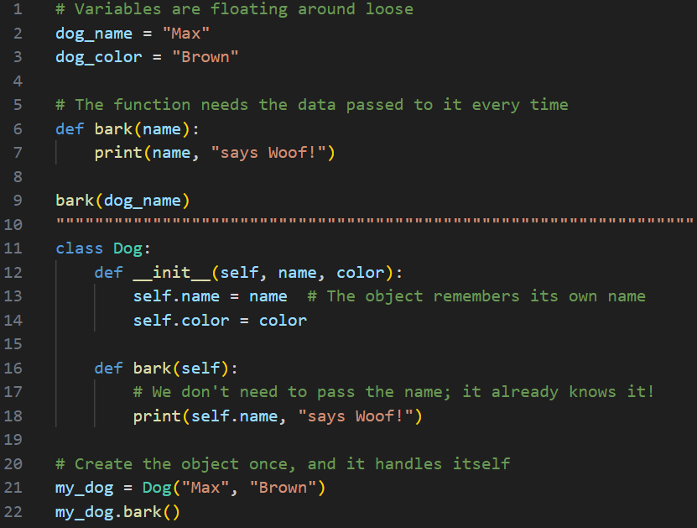
Practical exercise 01
Lab Task 1 – functions
*

Slide 13
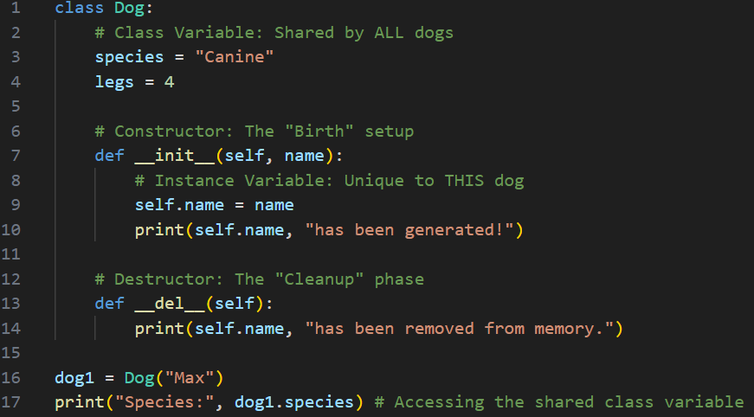
Practical exercise 02
Lab Task 2 – Variables & Constructors / Destructors
*

Slide 14
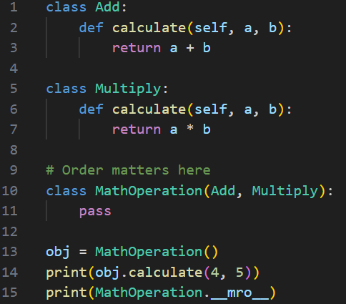
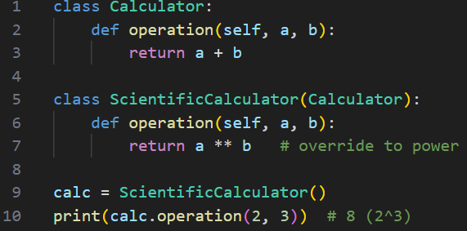
Practical exercise 03
Lab Task 3 – Inheritance & MRO
*

Slide 15
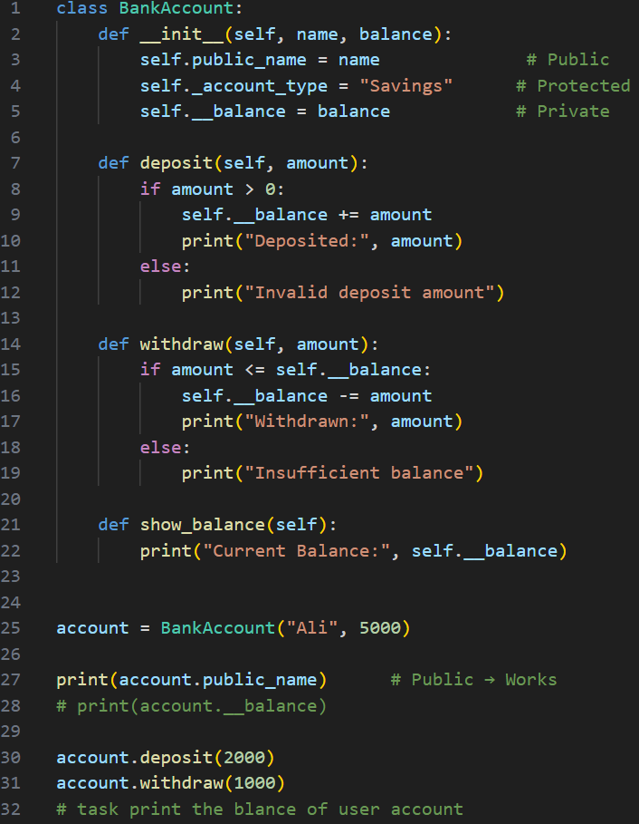
Practical exercise 04
Lab Task 4 – Specifiers / Security
*

Slide 16
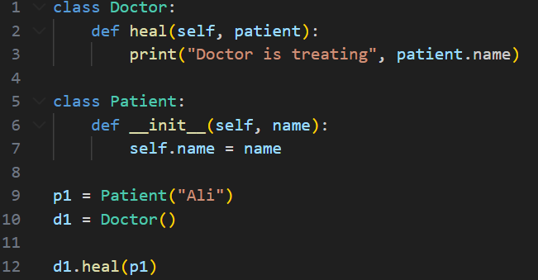
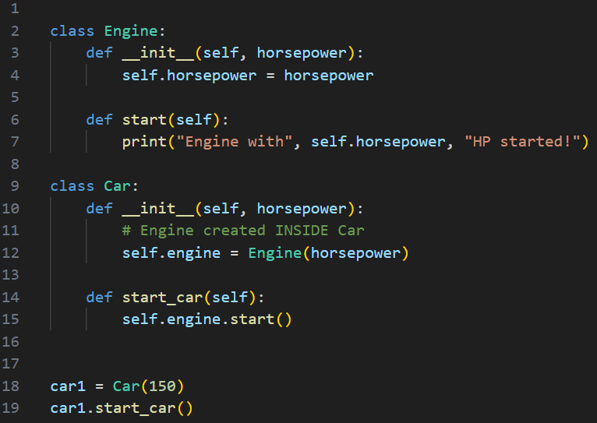
Practical exercise 05
Lab Task 5 – Advanced Relationship
*

Slide 17
Thank You for Your Focus Today!
What was the most
confusing
part of today's lab?
Waleed Khan
(Robotics Engineer | Senior Python Developer)
Email: 0xcloudcoder@gmail.com
Contact: +923126008702
}
*

